Slide 1




DISPLAYS SALES PERFORMANCE DATA
and Products
Dibimbing
DATA SERIES 10.0 PROJECT BUSINESS INTELLIGENCE
NABILA PUTRI ASY SYIFA

Slide 2

CASE STUDY
Create a dashboard in Tableau with Olist Dataset to help users
get insights, so business decisions can be taken quickly.
The dashboard will display insights on user questions
like:
What are the trends in orders and payment value per month each year?
What is the percentage of orders per payment value group?
- Expensive (> 750000)
- Medium (250 > 750
- Cheap (< 250)
How many customers and sellers and how many orders
in each state?
Draw a map of state and city distribution of the number of orders and
the amount of the payment value
How does each product perform?
Users will also be greatly helped if there are interactive filters or parameters,
such as Order Status, Payment Type, and others.

Slide 3
DATA UNDERSTANDING
In this case, using a sales dataset from 2017 to 2018, there are 4 tables used to visualize, including:
Orders Table: Order information
Order_Payments table: Payment information
Customers table: Customer information
Sellers Table: Seller information
Order_Payments
ORDERS
Customer
Sellers

Slide 4
DATA UNDERSTANDING
Order_purchase
timestamp
Order_id
ORDERS TABLE
Order_approved_att
Customer_id
This table is sales data information which contains order numbers, customer numbers, sales numbers, order status, and many others. You can see the details in the picture below.
Order_delivered_carrier_date
ORDERS
Seller_id
Order_delivered_customer_date
Product
Order_estimated_delivery_date
Order_status

Slide 5
DATA UNDERSTANDING
ORDER_PAYMENTS TABLE
Order_id
This table is payment data information that contains price, installment details, payment methods used, and many others. You can see the details in the image below.
Payment_value
ORDERS
PAYMENTS
Payment_sequential
Price
Payement_type
Freight_value
Payment_insallments

Slide 6
DATA UNDERSTANDING
CUSTOMERS TABLE
Customer_id
his table is customer data information which contains customer_id, customer region, both country and city and many others. You can see the details in the image below.
Customer_state
Customer_unique_id
Geolocation_lat
CUSTOMERS
Customer_zip_code
Geolocation_lng
Customer_city

Slide 7
DATA UNDERSTANDING
SELLERS TABLE
his table is customer data information which contains id_seller, seller region, both country and city and many others. You can see the details in the image below.
Seller_state
Seller_id
Geolocation_lat
SELLERS
Seller_zip_code
Geolocation_lng
Seller_city

Slide 8
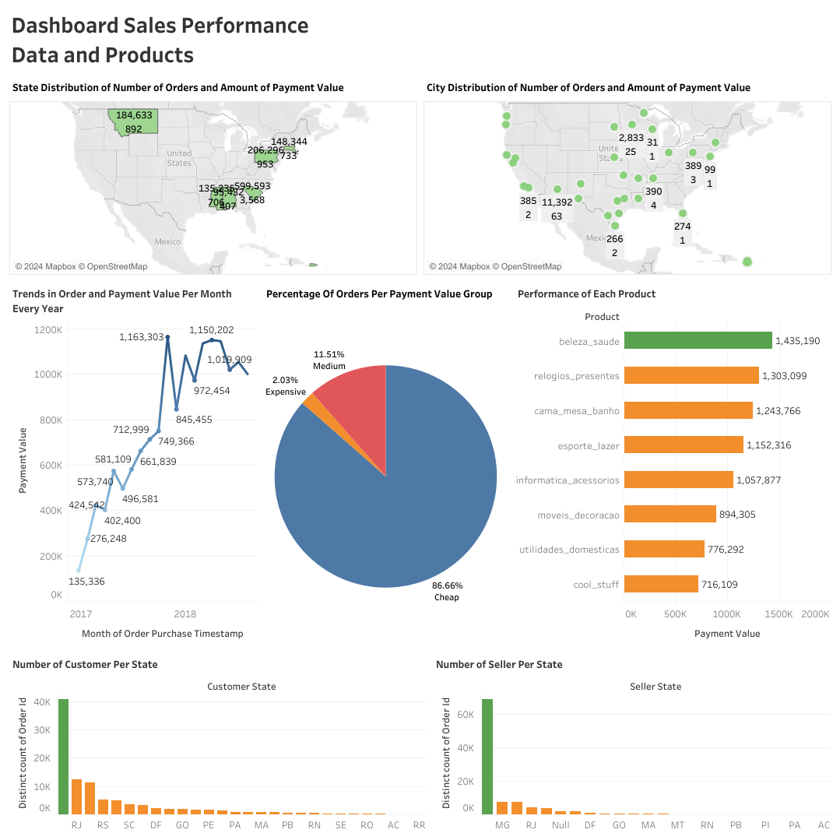
DASHBOARD

Slide 9
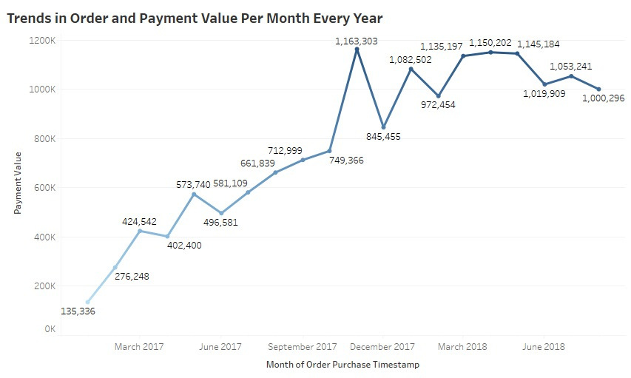
ORDER TRENDS AND PAYMENT VALUE PER MONTH EVERY YEAR
Order trends and payment values ​​have increased and decreased. In December 2017, it experienced the highest orders and payments, with a total of 1,163,303 orders.

Slide 10
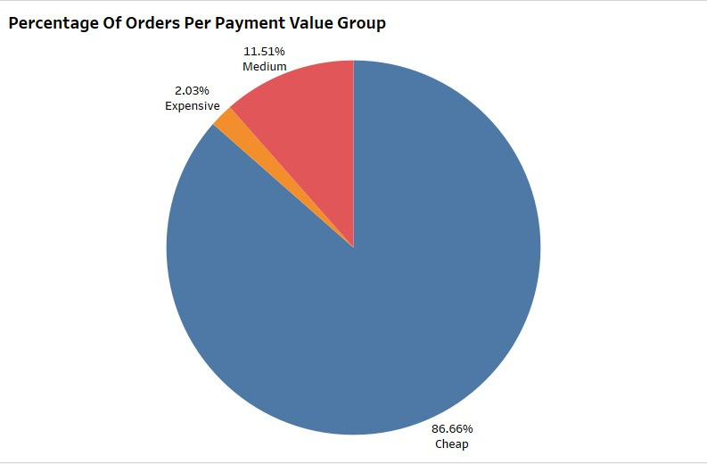
GROUP PAYMENT VALUE PERCENTAGE
The results of the visualization of the known percentages of the payment value group data consist of 3, namely cheap, medium and expensive.
Where there are different payment value group percentages. In the payment value group cheap has the highest percentage value, namely 86.66%, next has a medium percentage value, namely 11.51%, and expensive is in the lowest order, namely 2.03%.

Slide 11
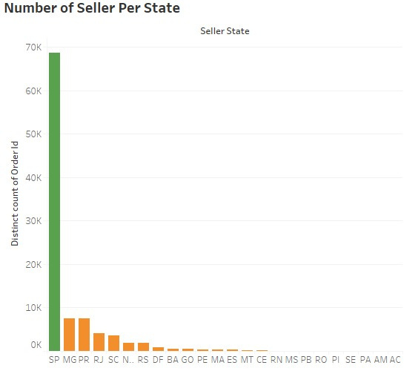
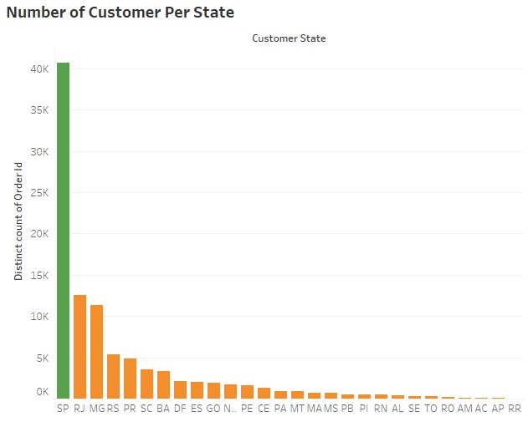
NUMBER OF ORDERS, CUSTOMER AND SELLERS IN EACH STATE
The following are the visualization results of the number of orders, customers, sellers in each country. Based on the visualization results, it can be seen that SP state has the highest number of customer and seller orders compared to other states. Underlining the order situation, it can be seen that a large number of sellers does not guarantee a large number of orders in an area.

Slide 12
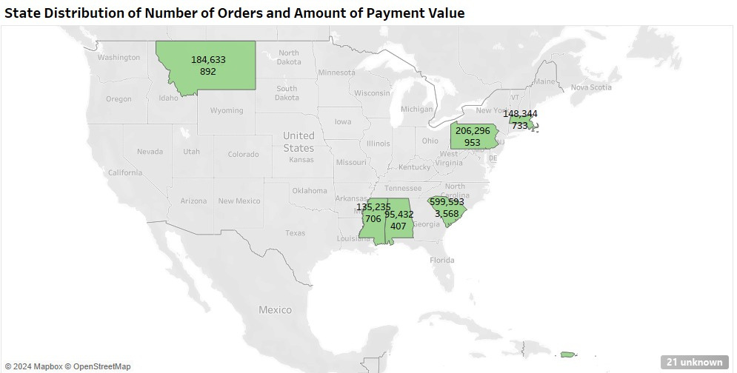
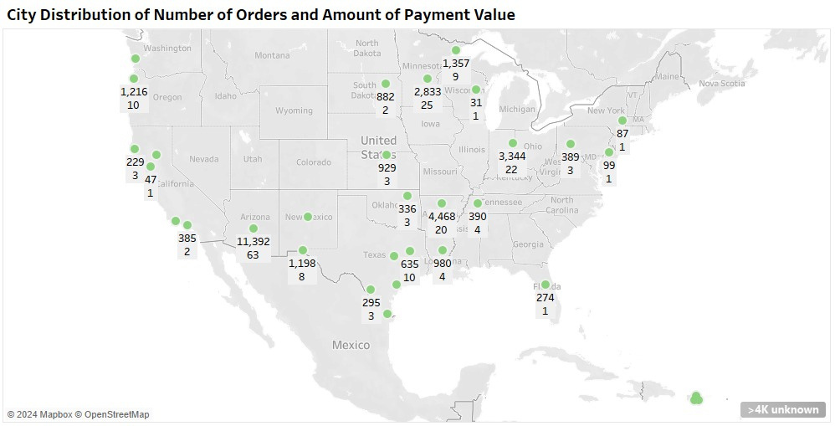
MAP OF STATE AND CITY DISTRIBUTION OF THE NUMBER OF ORDERS AND
the amount of the payment value
Visualization results from the state and city distribution map of the number of orders and total payment value. This is based on the country that has the highest score, namely customer state PA with a transaction value of 206.96 payments and orders of 953. Meanwhile, the city that has the highest score is the city of Rio Verde with a payment value of 11,392 and orders of 63.

Slide 13
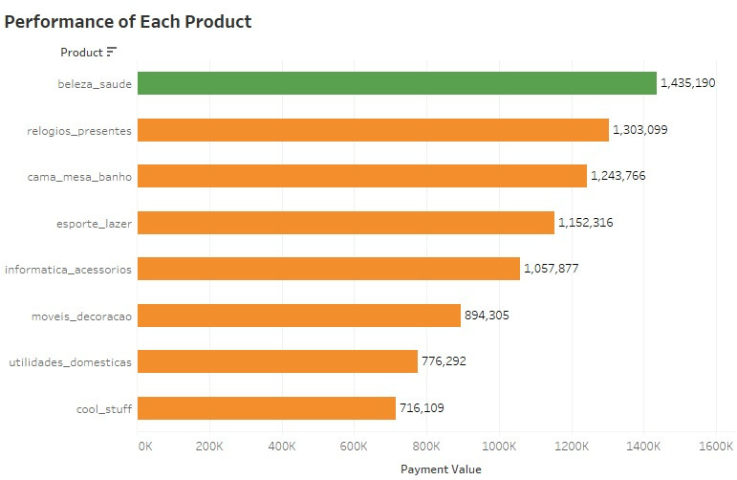
PERFORMANCE OF EACH PRODUCT
The following are the visualization results of 8 products that have high sales levels, during 2017-2018. It can be seen that the baleza_saude product is the best-selling product with total sales of 1,435,190.

Slide 14





Let’s Connect
+6285711942921
nabilaputriasysyifa99@gmail.com
www.linkedin.com/in/nabila-putri-asy-syifa-9b4788217
nabila_afs

